Slide 1
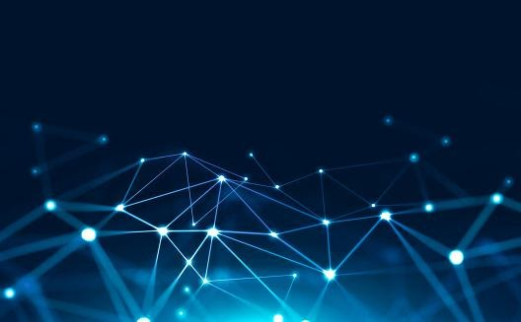
MEDICOBOT
Diagnose from wherever, whenever

Slide 2
TEAM MEMBERS AND MEMBER DETAILS
SRAVANTHI LAKSHMI GUNAMPALLI
GAAYATHRI MELLACHERUVU
Ph. No. : 9493325092
Email address : sravanthi.gunampalli@gmail.com

Slide 3
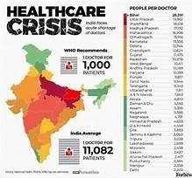
PROBLEM STATEMENT:
HEALTH CARE CRISIS
The doctor-population ratio in India is 1:1456 against WHO recommendation in the year 2020 onwards. The Economic Survey 2019-2020 has released information regarding the medical infrastructure evincing a shortage of doctors in the country. The doctor-population ratio recommended by the WHO is 1:1000.
On top of that ,more than 138 million patients are harmed every year by doctors' errors(be it misdiagnosis ,or prescription error, or surgical errors), the World Health Organization (WHO) warned, just a few days before celebrating the first World Patient Safety Day, with which it seeks to raise awareness of this ongoing tragedy
Lack of first aid skills and misconceptions kill as many as cancer. Approximately 140,000 people every year die in situations where their lives could have been saved if somebody had known first aid – as many deaths as there are from cancer, according to a campaign.

Slide 4
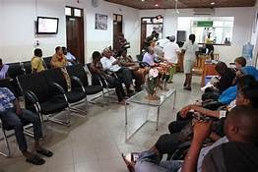
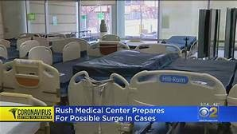
Close contact with harmful germs: Going to the doctor’s office means being around people who may be sick, often in close quarters. This can be particularly dangerous for those who have weak immune system.
Convenience to access care in comfort and privacy of their own home without compromising time off work for the healthcare which isn’t that serious and can be cured with proper guidance for ailments.
When there are barriers to treatment such as the COVID-19 lockdown and migration restrictions, a patient who lives far away from a medical care facility, or a patient who cannot transport themselves providers may expand the list of conditions they are willing to treat.

Slide 5
SOLUTION
Online diagnosis facilitates patient monitoring through computer or tablet or phone technology can reduce outpatient visits.
Remote diagnosis would allow less exposure to illness and infections lie for example when providers see patients remotely, they do not have to worry about exposure to any pathogens the patient may carry.
Telemedicine may make it easier for people to access preventive care that improves their long-term health.
Fewer times the patient who needs mild medication may not be financially stable, at those times it would be cost friendly in fact sometimes free to get diagnosis remotely.

Slide 6
The app makes it easier for any person to use in time of emergency.
The user can use the app for free diagnosis of health issue, depending upon the symptoms chosen your condition would be concluded whether it is serious or not and would suggest the respective department field of medicine to approach concerned doctor.
The user can get a simplified analysis of the report by highlighting the parts where deficiency or excess of any component in the body and can even get a BMI report just by giving required details.
The patient can get a complete analysis of what food has to taken and what food to avoid based upon whether the patient have diabetes or blood pressure.
There is an emergency module where if the patient need immediate help the voice message gets activated for nearby person to hear and help.

Slide 7
How it helps to solve the problem?
The app makes it easier to use by anybody at anytime without any efforts to help in case of emergency.
The user can get information regarding which doctor should be consulted for certain problem and can get any blood report translated to know whether you are fit and fine or not.
The user can get detailed analysis on food intake and food avoid depending on what lifestyle disease you are suffering through.
If the user needs emergency and need help from someone nearby but couldn’t reach out to call then by our app a voice message gets activated for nearby person to get alert.

Slide 8
Impact metric to analyze useability of solution
India’s population is more than 138 crores which is huge and every person to get diagnosed by qualified doctor readily is difficult at times. Our app provides free diagnose upon which concerned department of medicine can be approached and it provides diet foods to consume regarding the lifestyle disease you are facing and the emergency module is what makes the app more useable in case of any emergency.

Slide 9
Frame works, tools, and technologies
This program was developed using python(idle shell 3.10,64 bit)on windows 11 , and the following modules were imported:
1. cv2 (to read the image for report scanning)
2.pytesseract (for image to string conversion in report scanner function)
3. re (verify set of strings and match it)
4.IPython.display (used in diet module of the program)
5.playsound (to play the audio file for emergency module)
Note: tesseract.exe had to be downloaded to execute pytesseract.

Slide 10
Assumptions and Constraints
If we imagine going to hospital for some health issue we calculate time to reach hospital and time for doctor availability sometimes pre-appointment. But there are limitations here again, at odd times approach of a well qualified doctor availability is difficult.
By using our app we help you analyse which department of doctors you should be consulted by saving sometime and in case you are stuck at any emergency helpless situation.
You might need a help from someone nearby to help you out then our app has feature through which a voice message gets activated and through the sound released a person nearby can come out to reach you and help.

Slide 11
Ease of Implementation
Python is a universal programming language that is appropriate for solving a wide range of tasks. And everybody knows that it is used in such spheres as web development, data science, and d
Python is rather versatile. It can be used for building various apps: starting with web-browsers and ending with simple games.
One powerful advantage is being cross-platform. So, it’s possible to develop both Android and iOS apps in Python
different processes automation , meaning this program can be easily modified to be implemented and ran in both android and ios operating systems.

Slide 12
Scalability and Useability
The features that would be available now can be updated with lot more creative ideas in future by maintaining its performance.
People in remote places can also use freely with ease as most of the questions asked for diagnosis are direct and easy to answer.
It provides user friendly environment as it is accessible to anyone to use from wherever and whenever.

Slide 13
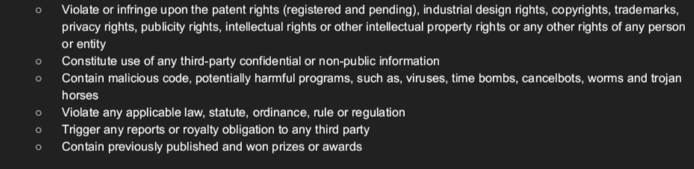
We declare and represent that our submission represents our original
Work and does not represent the following:

Slide 14

METHODOLOGY
VISUALISATION COMPONENTS THE SOLUTION
General DIAGNOSIS:
Symptoms
report scanner and analyzer
BMI calculator
DIET ASSISTANT
EMERGENCY

Slide 15
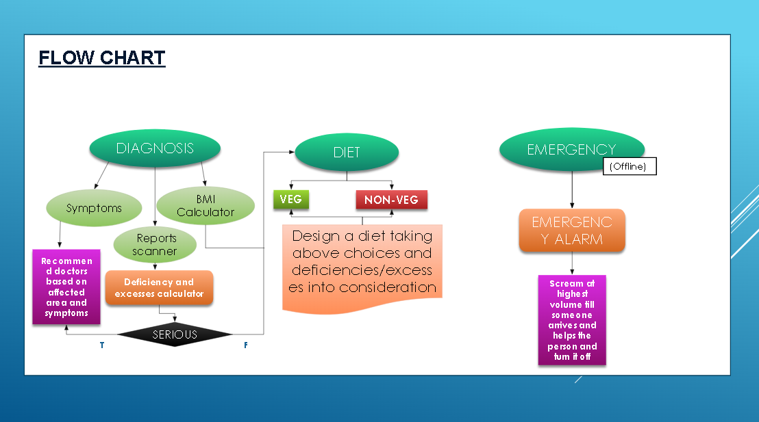
Emergency alarm

Slide 16
ANALYSIS AND INSIGHTS:
This solution would help enable contact free diagnosis and prevent spread of harmful diseases.
This solution would make diagnosis of diseases affordable and could potentially help track the spread of a specific disease.
This solution could take the heat off of the medical community , and could pave way to technological developments , which would assist them with technical aspects(like calculations , numerical data handling) and precision work(like surgery).
The emergency module would call for help when the person is in no position to do that by blaring an alarm , attracting the attention of a passerby.
Involvement of artificial intelligence in the field of medicine may seem like a huge risk initially, but in the long run , training an AI bot(and updation of new breakthroughs in the field of medicine almost everyday) is easier and would be more efficient than teaching a human.
Debunks myths related to diet habits.
It also, In a way , promotes body positivity by eradicating unhealthy beauty standards.

Slide 17
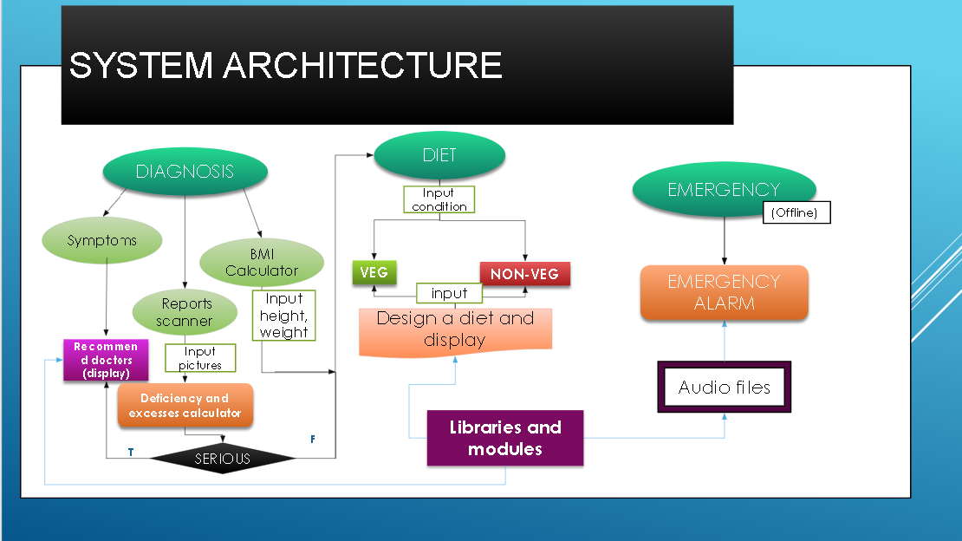

Slide 18
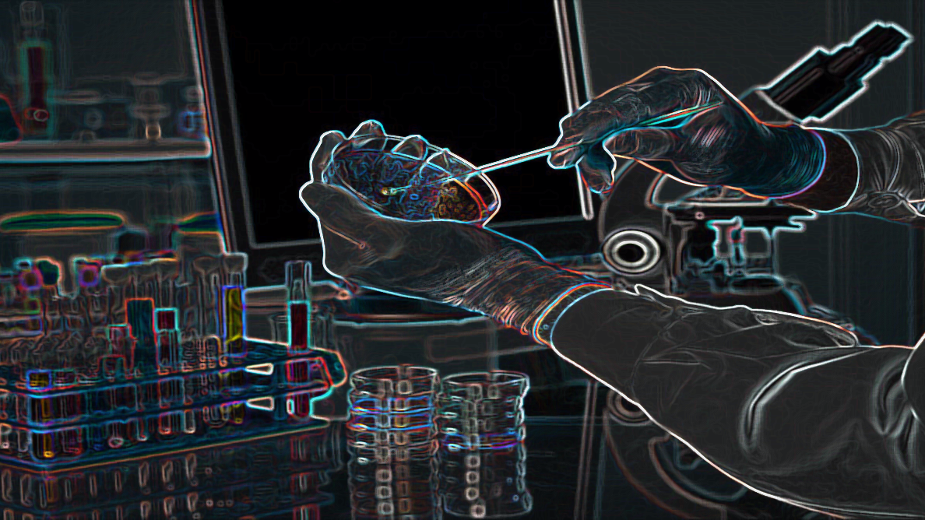
WORKING:
Upon activation , the screen would display 3 options:
1.Diagnosis
2.EMERGENCY
3.Diet
EMERGENCY:
The emergency module is an option for when you are in a life and death situation and are in no position to call for help.
As soon as the module is picked, the user will be asked if its truly an emergency . If the answer is yes , an uninterruptable audio will be played to call for attention of a passerby.
If the answer is no , the user will be redirected back to the options screen.

Slide 19
DIAGNOSIS:
If diagnosis is chosen , 3 options would be displayed:
1.symptoms
2.reports scanner
3.BMI
Symptoms: upon choosing this option , the person would be asked a series of multiple choice questions regarding the patient and condition ,and would be recommended a doctor(oncologist ,dermatologist , etc.)based on the responses received.
Reports scanner: this would scan numerical data related reports and convert the image to text and then take in the values . after taking the values , it will check whether they fall in healthy ranges , and store the ones that don’t , and then calculate the deficiencies and excesses . After calculating , the condition is displayed(this condition can be copy pasted in the diet column and a diet can be charted).
BMI: this would calculate the body mass index from inputs of height and weight, and compare with the ranges and calculate if the person is underweight or overweight.
DIET: if this option is chosen , the person would be asked the condition they have. Next they would be asked if they want a veg diet or a non veg diet, and a diet would be displayed accordingly and it will recommend foods to consume and foods to avoid.

Slide 20
Video demonstration link
GOOGLE DRIVE LINK:
https://drive.google.com/drive/folders/16PP3BTogSEQflIlwYMRxKYL6poudThEY?usp=sharing

Slide 21
ATTACHMENTS:
Screenshots from the solution can be found below:
https://drive.google.com/drive/folders/1GqxRAss1mRxQB1X3usvnVRf6wFMsCjNc
Github link for code:
MEDICObot/README.md at main · GaayathriMellacheruvu/MEDICObot (github.com)

